Slide 1
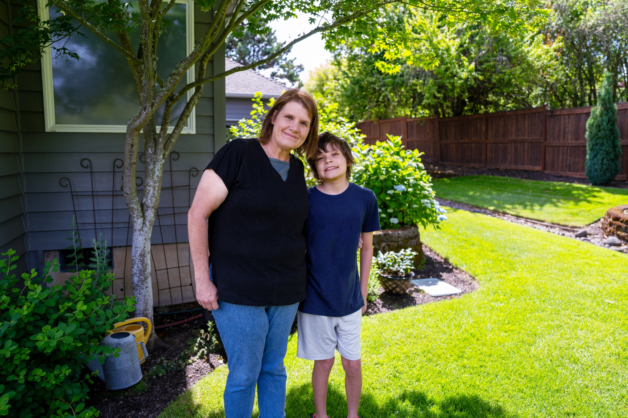
Access to Justice in Oregon CEJ Southern Oregon Regional Event at Edenvale October 10, 2024

Slide 2
Access to Justice
When a person facing a legal issue:
1. can understand their legal problem,
2. has timely & affordable access to legal help to address the problem, and
3. walks away believing they were treated fairly in the process.

Slide 3
Justice Builds: Meggan’s Story

Slide 4
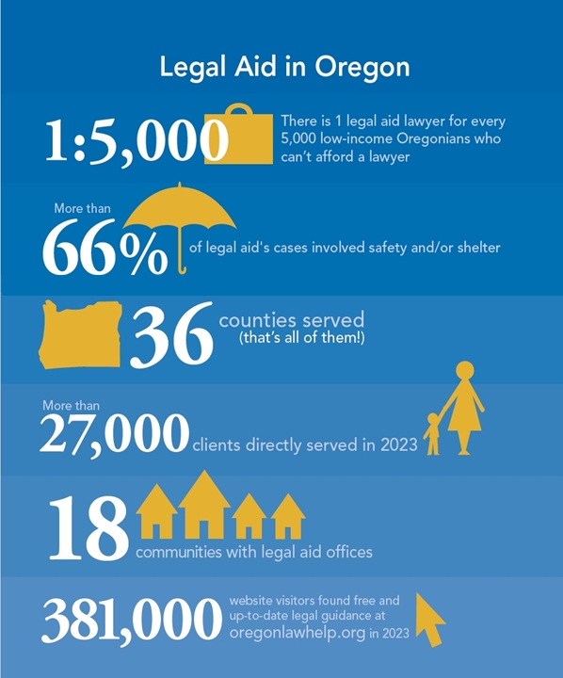

Slide 5
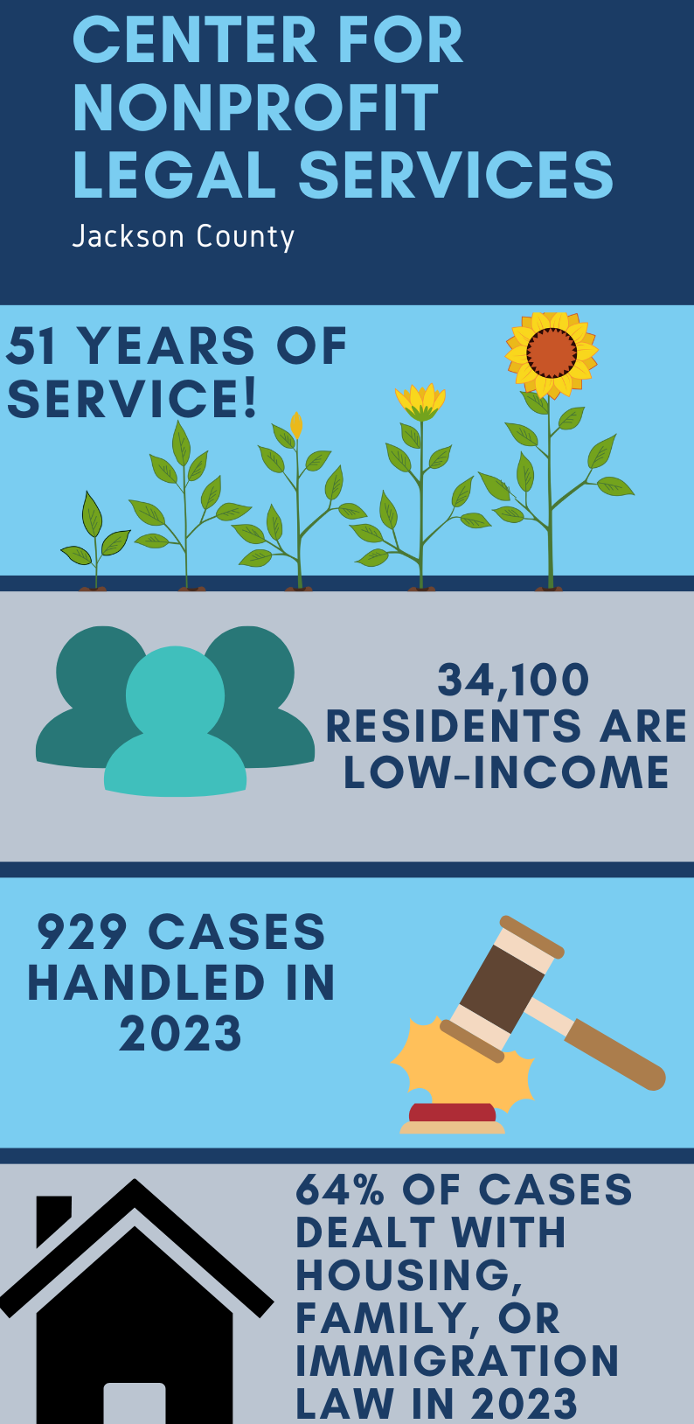

Slide 6
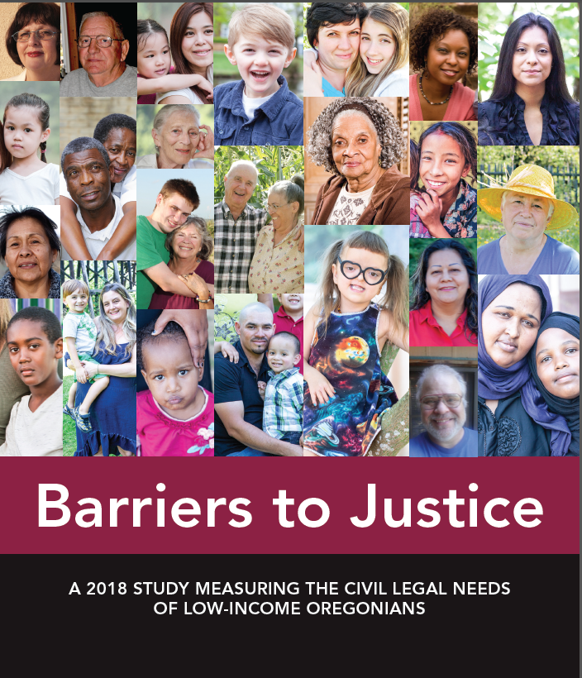

Slide 7
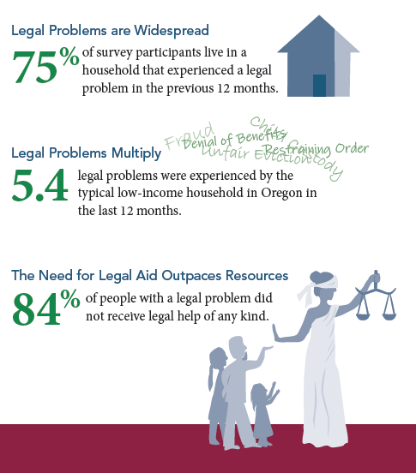
The Study Findings Are Stark

Slide 8
Most Common Legal Issues

Slide 9
How Legal Issues Affect Lives

Slide 10
The Snowballing Effect
Abuse survivors were:
Those with records were:
6.2x more likely to face homelessness
3.7x more likely to have education-related legal issues
2.1x more rental issues
9.8x more likely to face homelessness
2.5x more likely to have family law issues
2.2x more likely to have elder law or disability issues

Slide 11
Disparate Effects
Black Americans:
Asian Americans:
Native Americans:
2.3x more likely to face homelessness
2.1x more likely to face an education-related legal issues
1.8x more policing issues
1.6x more rental issues
2.6x more homeownership issues
2.4x more veteran-related legal issue
2.1x more immigration issues
2.7x more veteran issues
1.9x more disability issues
1.9x more mobile home issues
1.5x more homelessness
1.5x more health issues

Slide 12
Changes since 2018

Slide 13
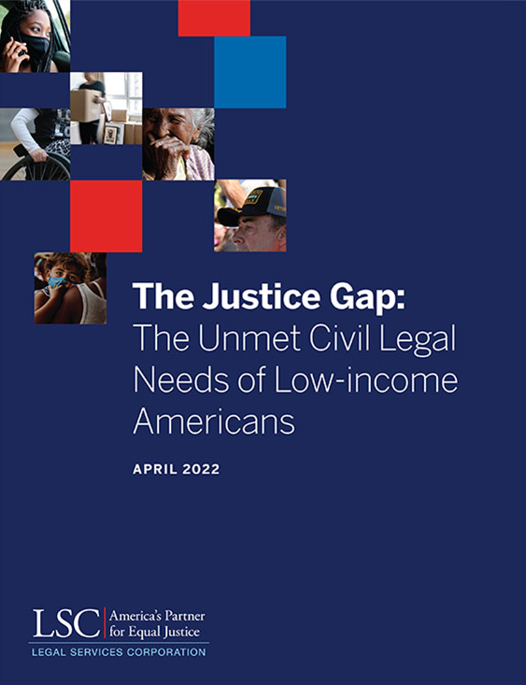
By 2022, 92% of the civil legal problems reported by low-income Americans received inadequate or no legal help.

Slide 14
Concerns about the cost of legal help stand out as an important barrier to seeking and receiving legal help.
Nearly one-half (46%) of those who did not seek legal help for one or more problems cite concerns about cost as a reason why.

Slide 15
Higher Income = Fewer Barriers

Slide 16
Civil Legal Aid Increases Trust by Improving the Judicial System
Reduces number of self-represented litigants.
Provides representation in high-volume and impactful legal areas.
Fairness in the Legal System
Reduces court congestion.
Increases trust, understanding, and confidence in the legal system.

Slide 17
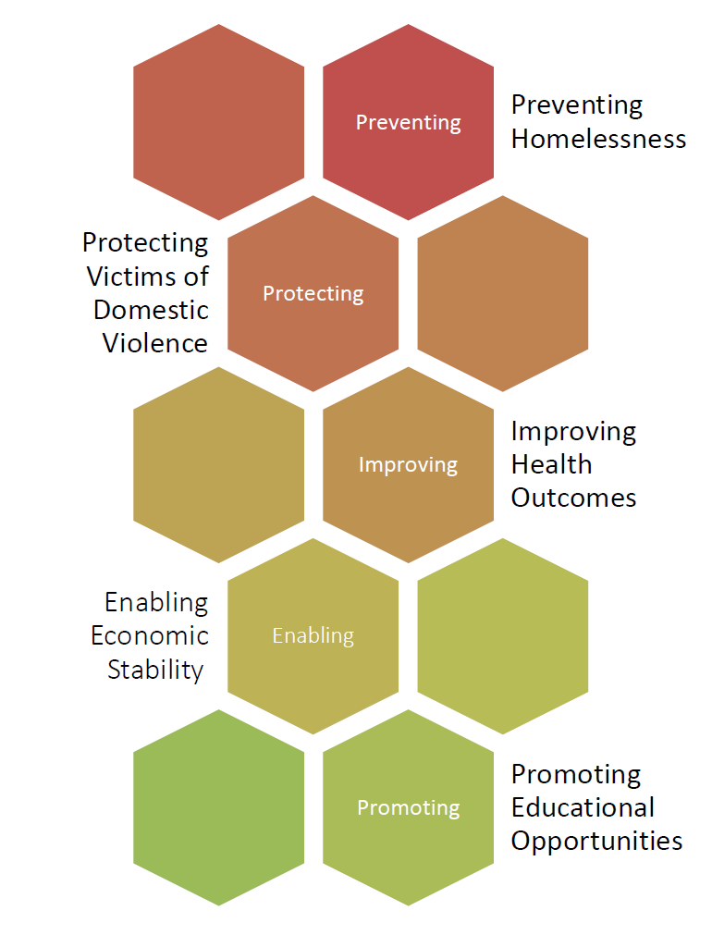
Civil Legal Aid Supports Systems
Civil legal aid can prevent and solve problems associated with inequality and poverty, reducing the need for other resources and services.

Slide 18
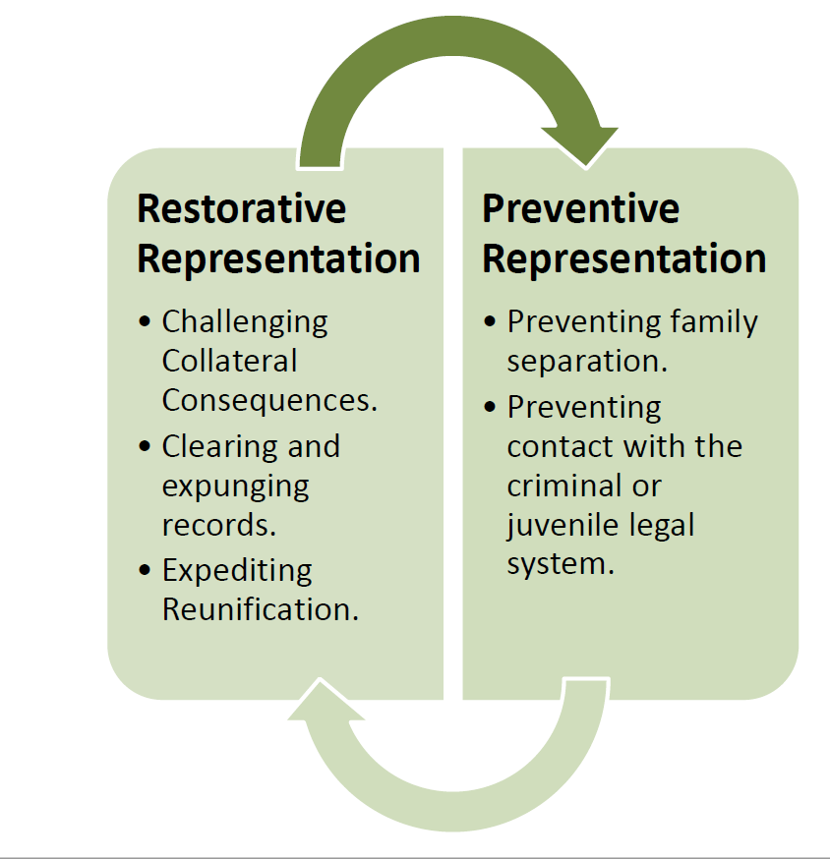
Civil Legal Aid is an Upstream Tool
Access to high-quality civil legal services can also prevent or minimize contact with the criminal, juvenile justice and dependency system.

Slide 19
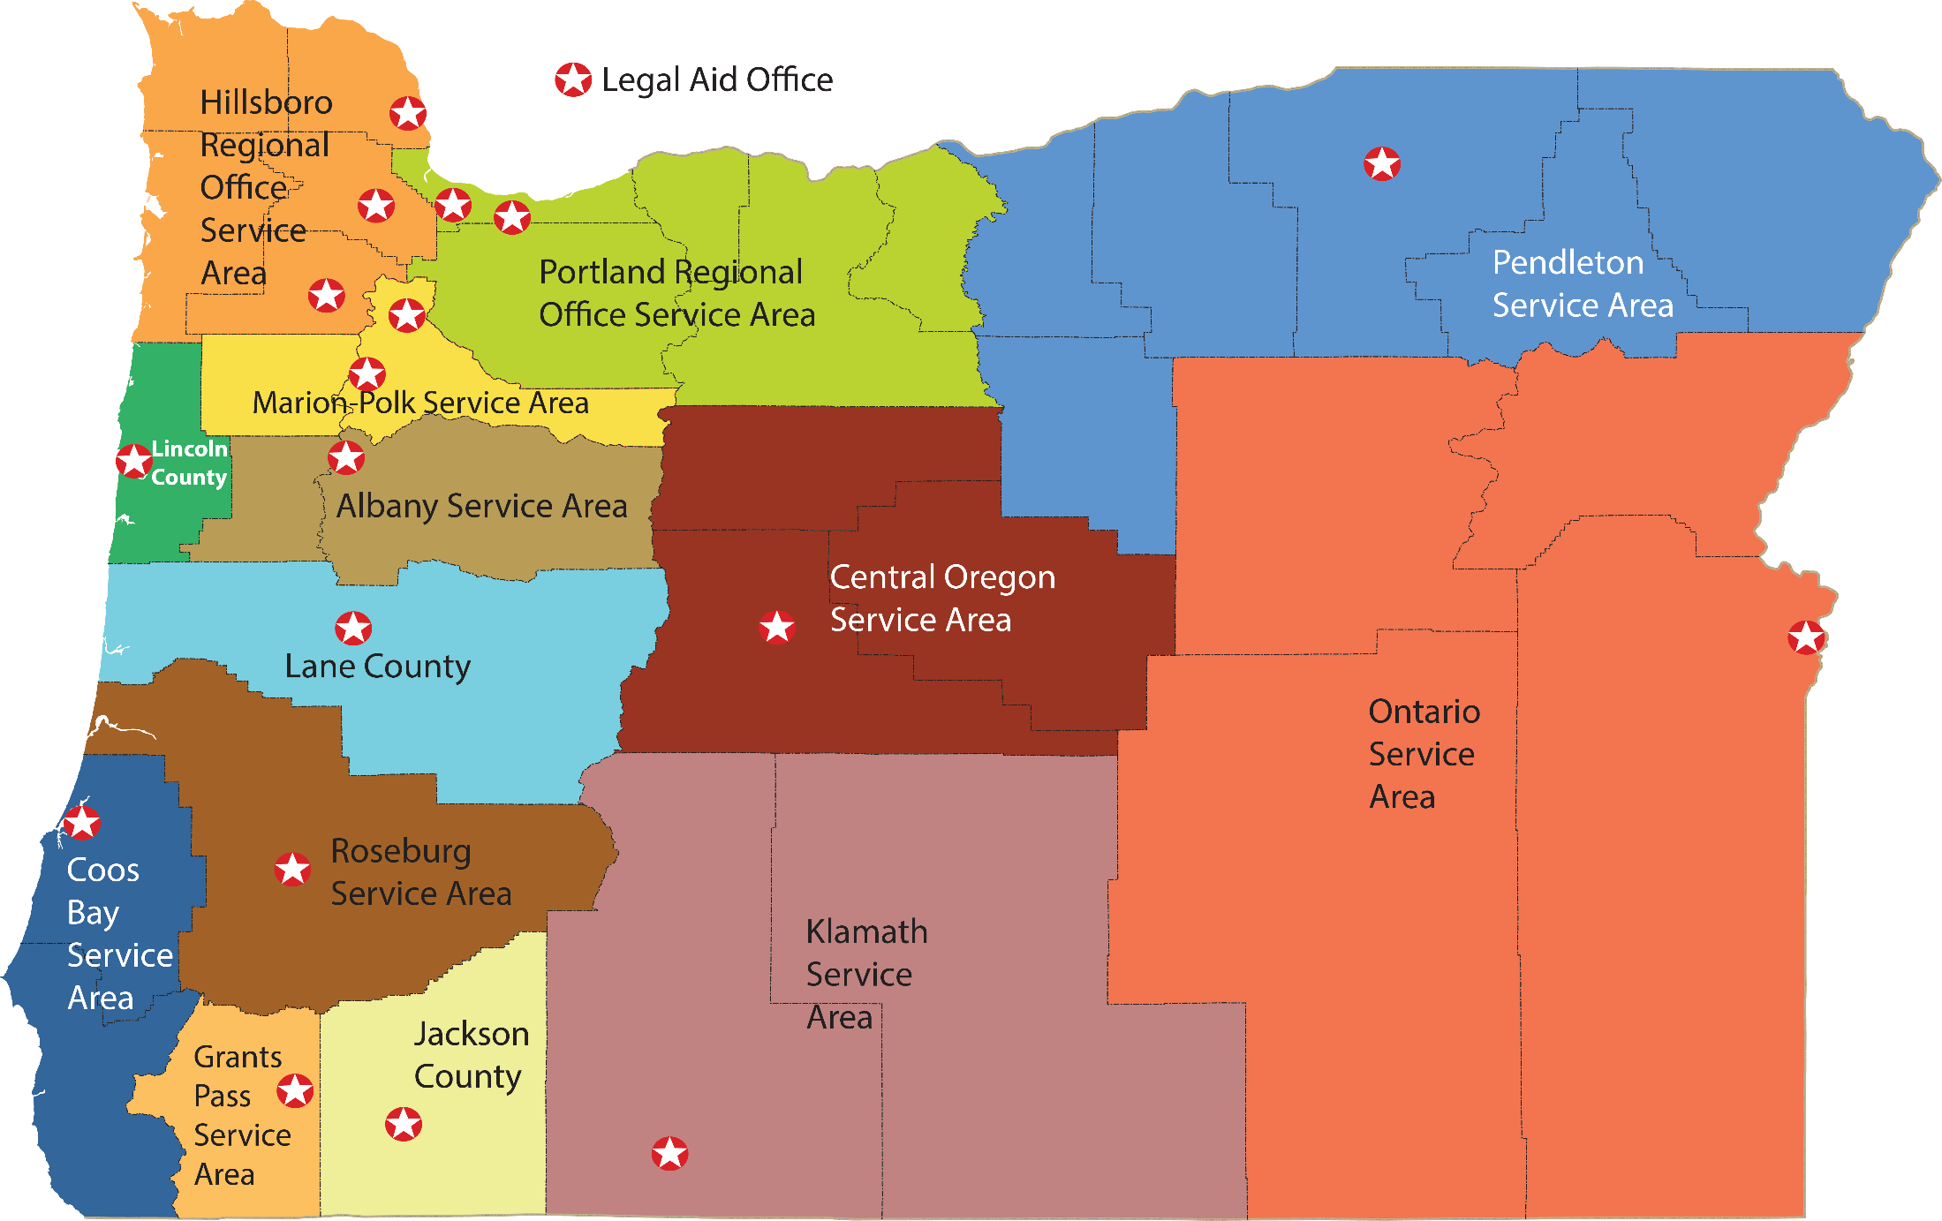
Legal Aid Offices

Slide 20
2024 Income Eligibility
Number in Family | 125% of Federal Poverty Level
1 | $18,825 per year $1,569 per month
2 | $25,550 per year $2,129 per month
3 | $32,275 per year $2,690 per month
4 | $39,000 per year $3,250 per month

Slide 22
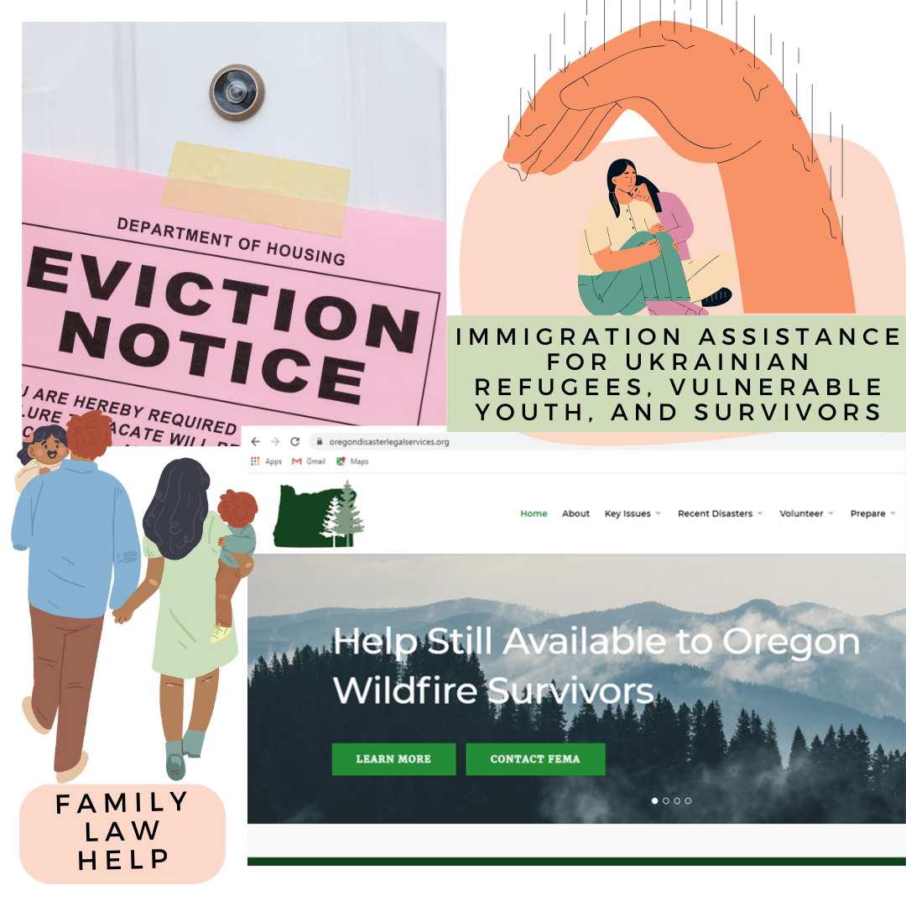

Slide 23
The Portal Project at: oregonlawhelp.org
Goal: A centralized and simple pathway for Oregonians to understand their civil legal
problems and connect with resources that can help
Principles: (1) Single Entry Point
(2) Accessible and Accurate Content
(3) User-Centered Design
Progress: Launched in January 2024

Slide 24
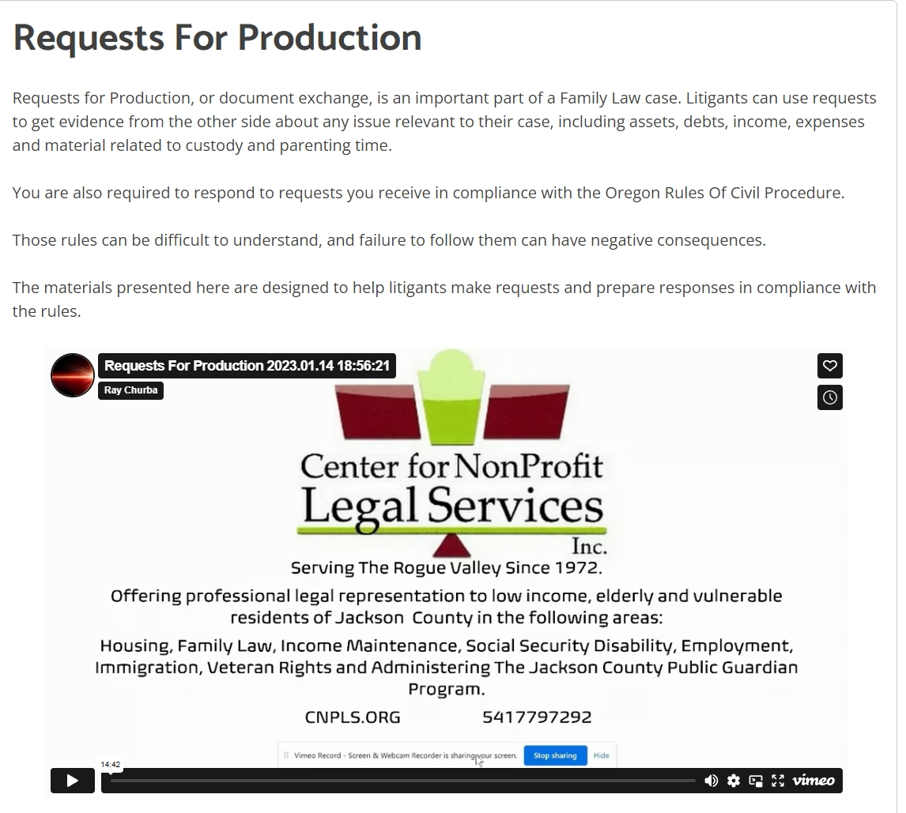
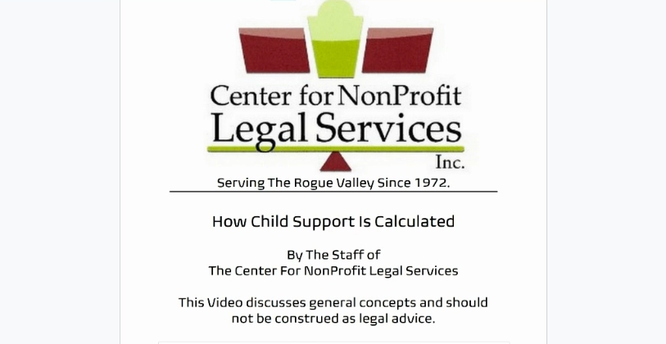
FAMILY LAW VIDEO SERIES EXAMPLES:

Slide 25
An aspiration: 80 hours of pro bono services.
80

Slide 26
Direct legal service to people with low incomes: 20 to 40 hours or two cases.
20 to 40
80

Slide 27
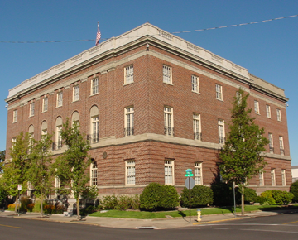
Jackson County Pro Bono Bankruptcy Clinic

Slide 28
Benefits of Volunteering with Legal Aid
Mentorship and Support
Certified Pro Bono Program-PLF Coverage
Access to Trainings and Resources
Notes:
1. Periodic CLE’s and Brown Bag Discussions - www.oregonadvocates.org
6. LASO & OLC are certified PB providers

Slide 29
Save time on CLEs with pro bono: 1 MCLE credit for 2 hours pro bono.

Slide 30
No time? Give instead.
“If a lawyer is unable to provide direct legal services to the poor, the lawyer should endeavor to make a comparable financial contribution to an organization that provides or coordinates the provision of direct legal services to the poor”

Slide 32
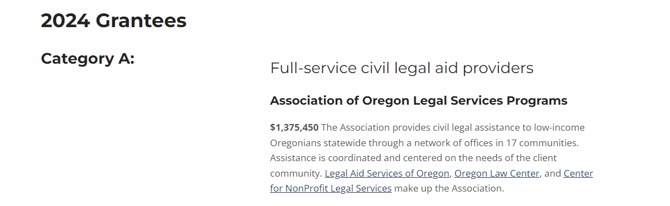

Slide 33
Bank where it matters: Oregon Law Foundation Leadership Banks.
368x
1

Slide 34
Leadership Banks & Credit Unions
Visionaries: 3.68%+ interest
Bank of Eastern Oregon
Beneficial State Bank
Columbia Credit Union
Community Bank
Heritage Bank
Lewis & Clark Bank
Northwest Bank
OnPoint Credit Union
OR Community Credit Union
Pacific West Bank
Pioneer Trust Bank
Summit Bank
Umpqua Bank
Washington Trust Bank
Wells Fargo Bank

Slide 35
Leadership Banks & Credit Unions
Advocates: 3.15% to 3.67% interest
Bank of America
BankUnited
Chase Bank
Esquire Bank
1st Security Bank of WA
KeyBank
Oregon Pacific Bank
Willamette Valley Bank

Slide 36
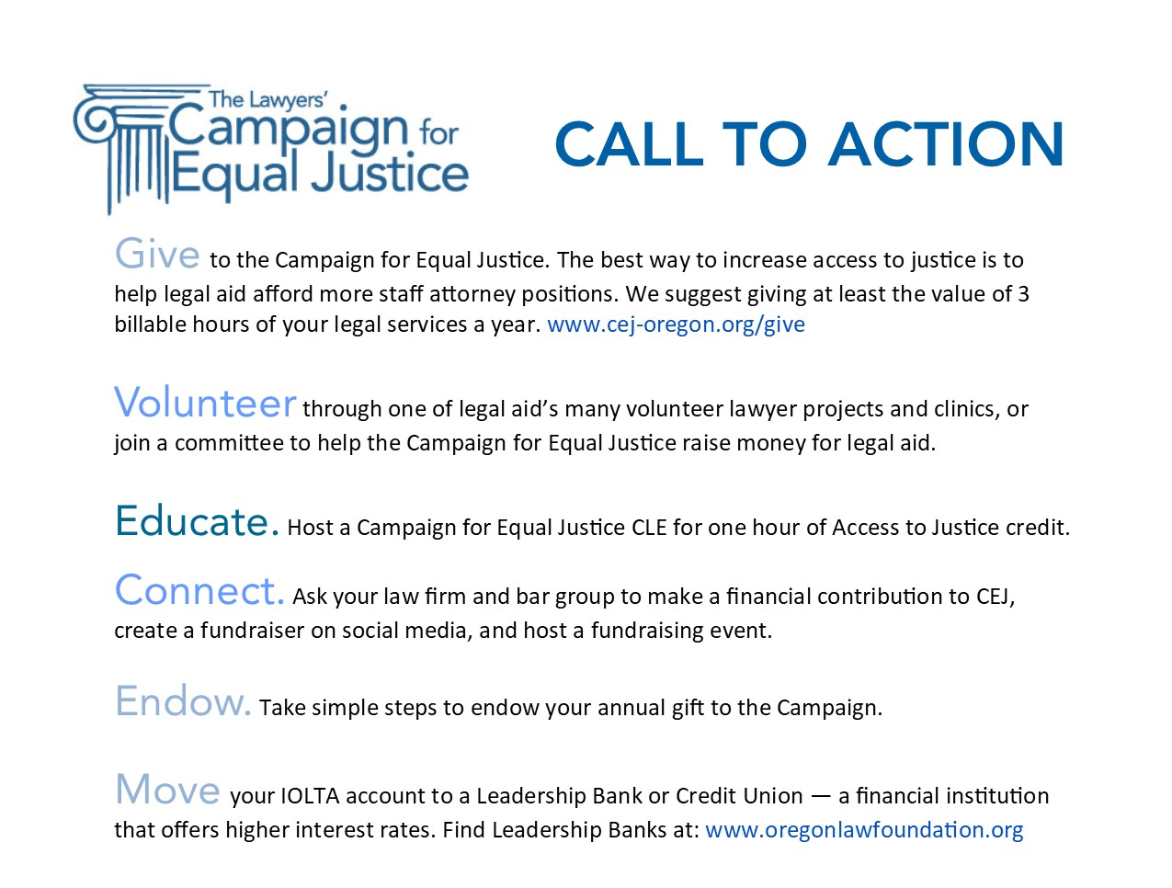

Slide 37
Thank You!
Ayla Ercin
Executive Director
Campaign for Equal Justice
ayla@cej-oregon.org
Ray Churba
Staff Attorney
Center for NonProfit Legal Services
esqray@gmail.com

